Slide 1
Explaining Incomplete Tryptic Cleavage of the Parent Protein
By Ahmad Arnaout
1

Slide 2
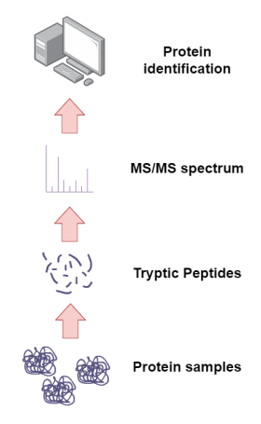
Peptide Detectability in Proteomics
The primary aim of proteomics are the identification and quantification of expressed proteins in cells.
However, Protein sequence coverage rarely exceeds 25%.
Presence of certain proteins can be stated by mapping peptides to database sequences.
Certain peptides are more detectable than others.
Observed Peptides in MS
Inferred Protein Sequence
Notes:
As you all know, proteins are an essential part of biology. So being able to identify and quantify proteins are important in understanding biological systems in the field of Proteomics. In bioinformatics, we come across a lot of data of this type using high-throughput methods such as mass spectrometry (MS) based proteomics where we break down protein sequences into peptides using cleavage enzymes like trypsin in bottom-up proteomics approach and mapping them to peptide databases to accomplish the primary aim.
However, due to the use of peptides rather than whole proteins, there is a limited protein sequence coverage by identified peptides, which reduces the confidence in protein identification. Likewise, many same peptides match to multiple different proteins, leading to protein ambiguity, which makes it difficult to determine which protein is present. The low coverage might be explained by the limited time the cleavage enzyme has to cleave proteins before being put through instruments.
Reason why more peptides are more detectable than others:
Sample matrix interfering with detection
Abundance of certain peptides
Fractionation and mass range

Slide 3
Protein Digestion by Trypsin
Peptides bonds in proteins are typically cleaved by an enzyme called trypsin into smaller peptides.
ALEWLGADRNEGRRHAAVLVLRELAISVPTFFFQQVQPFFDNIFVAVWDPKQAIREGAVAALRACLILTTQREPKEMQKPQW
ALEWLGADRNEGRRHAAVLVLRELAISVPTFFFQQVQPFFDNIFVAVWDPKQAIREGAVAALRACLILTTQREPKEMQKPQW
Length: 5 10 15 20 25
| | | | |
R
EPK
NEGR
QAIR
EMQKPQW
EGAVAALR
HAAVLVLR
ALEWLGADR
ACLILTTQR
ELAISVPTFFFQQVQPFFDNIFVAVWDPK
| | | | |
As per Keli’s rule, trypsin catalyses the hydrolysis of peptide bond at the C-terminal of K and R, unless followed by P.
HOWEVER, sometimes cleavage sites are missed, so longer peptide may be produced, i.e. QAIREGAVAALR
Notes:
The common enzyme used in these experiments is trypsin. As mentioned in slide 1, trypsin catalyses the hydrolysis of peptide bond at the C-terminal of K and R; although, due to Proline’s(P) inhibitory property of peptide cleavage; if a proline residue is the next amino acid residue after R or K, cleavage will not occur. As a consequence, trypsin will move along the sequence and cleave at the next tryptic site without Proline as the next residue, this is known as Keil’s rule.
However, there is a clear limitation in bottom-up proteomics approach that arises due to incomplete digestion, where trypsin does not cleave tryptic sites (given Keil’s rule is followed) resulting in missed cleaved peptides which are not expected downstream for protein identification.

Slide 4
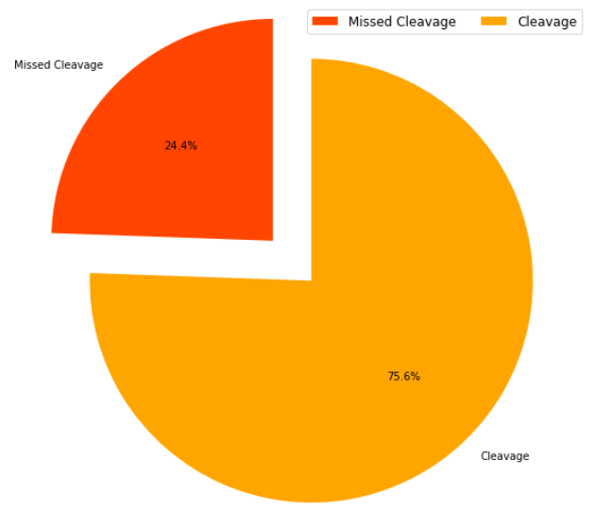
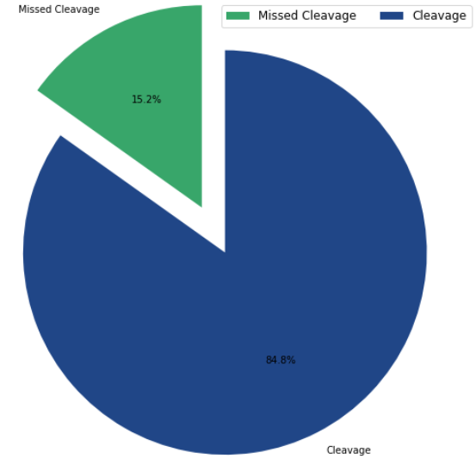
PTEN Dataset
A2 Dataset
Notes:
This can be clearly shown in the two pie charts where there is still missed cleavages happening from the two datasets gathered from Human prostate cancer cell lines during research . The method in identifying and quantifying proteins in samples in bottom-up proteomics is complicated, as many peptides go undetected, resulting in low coverage and ambiguous proteins, to which numerous copies of the same peptide map. The impact incomplete tryptic digestion affects which peptides enter the mass spectrometer. These missed cleaved peptides which enter the MS can cause difficulty when identifying expected peptides for mapping to proteins and this will decrease the confidence of protein identification which can contribute to one of the biggest sources of error in the bottoms up proteomics approach.

Slide 5
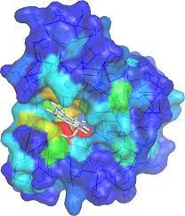
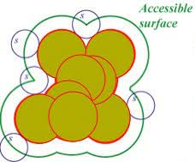
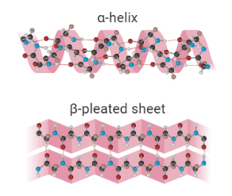
Causes of Incomplete Digestion
Is there any correlation between the missed cleavage sites and their position in the protein structure ?
Relative Accessible Surface Area (RSA)
Secondary Structure/ Protein Folding
Residue Depth
Notes:
There can be multiple reasons for incomplete digestion, from laboratory preparation to parameters and conditions (temperature or pH) during protein digestion. These experimental conditions can be adjusted to minimise incomplete digestion; although, even after adapting optimal conditions there are still incomplete digestion. Therefore, we have led to hypothesize that the reasons for this can be ascribed to protein structure and its interaction with proteolytic enzymes, creating missed cleaved peptides. So, when we looked looking at potential causes of missed cleavage at the structural level , we have determined there are many properties to consider, such as secondary structure, residue depth, protein folding and accessibility of the residue by trypsin.

Slide 6

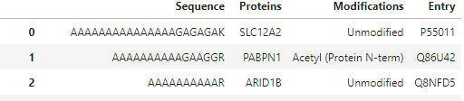




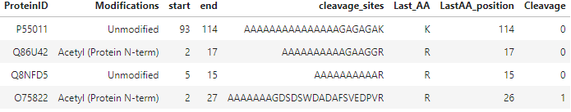
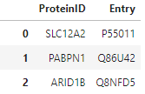
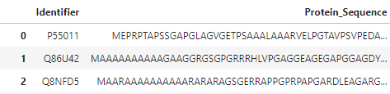
Data Gathering & Quality Control
2. Data Wrangling
1. Raw Mass Spec Data
Filter Dataframe to Sequence , Proteins, Modifications
HPLC-Tandem MS/MS/ MaxQuant Raw Data in TSV format
Loading Data inro Python Jupyter Notebook
TSV into Pandas Dataframe
Eliminating Duplicates
326,834
Peptides
52,079
Peptides
3. Uniprot Dataset
4. Sorting Cleavage Labels
Extracting & Adding Uniprot ID and Protein Sequences to Dataframe
Cleaved Correctly =1
Missed Cleavage =0
Notes:
To carry out the research, data processing and wrangling tasks were performed using Python and various packages in jupyter notebook where duplicate sequences have been removed. The third step involves utilising the Uniprot API, where the Protein ID and whole protein sequence were identified using gene names from the Dataframe as the search target. The protein ID & sequence is important downstream to search for predicted 3D structures from AlphaFold, the data from the predicted model will be used in the calculation of various features of interest.
To accomplish the fourth step, the start and end position for each peptide in the corresponding protein sequence were calculated, and a regular expression was used was used to find all the peptides which contained missed cleavage sites and the position of the missed site to calculate the frequency of missed cleavages where a new row of peptide sequences with only the missed cleavage peptide and correctly cleaved peptides. As a result of this split, the data can be labelled into 2 categories: correctly cleaved (0) and missed cleavages (1) .

Slide 7
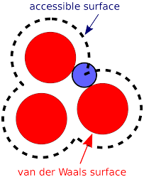
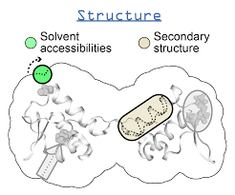
Structural Feature Calculation & Addition: I
The AlphaFold protein structure database , consisting of 23,391 human protein 3D structures, have been explored & downloaded as a Protein Data Bank (PDB) file or macromolecular structural (mmCIF) file.
These files includes the data regarding the secondary structure and using a free software called DSSP, the secondary structure and RSA can be calculated using the protein ID and the “LastAA_postion” from each peptide in the DataFrame.
Notes:
As discussed previously, the secondary structure could potentially affect missed cleavage and for this reason 23,391 human protein 3D structures that have been accurately predicted (95% confidence interval) as a protein databank file (pdb) or mmcif file. The DSSP module which serves as a dictionary of secondary structure software used the files to calculate the secondary structure and relative solvent accessibility (RSA) which may be able to explain missed cleavages similarly to secondary structure. RSA is a structural characteristic that quantifies how deeply a protein residue is buried or exposed in the three-dimensional structure. The RSA value is within the range of 0 and 1 and the commonly used threshold to classify buried or exposed status of a residue is 0.25 where any value below 0.25 suggest the residue is buried.

Slide 8
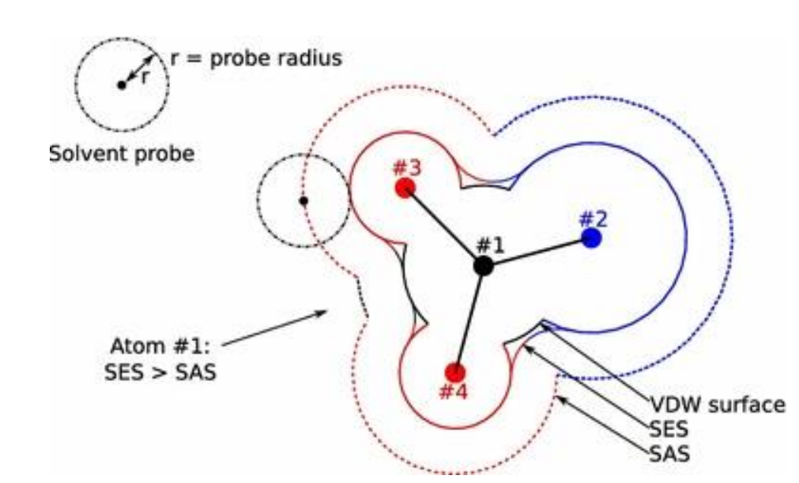
Structural Feature Calculation & Addition: II
The second application used to calculate other secondary structures is biopython’s residue depth module which uses the software MSMS.
It calculates the residue depth and the Cα depth from the input taken same PDB file that DSSP uses.
Notes:
The second software that was used is MSMS which calculates another structural feature called residue depth. Residue depth is the average distance between a residue's atoms and the surface that is exposed to solvents. Cα depth is the distance of a residue’s alpha carbon atom to the solvent accessible surface.
The residue depth is calculated using the solvent accessible surface area (SASA), which is the area of contact between protein and solvent can occur and the solvent excluded surface (SES). While SASA is drawn out by the centre of the probe, SES is the topological boundary of the probes. The probe is used in the rolling ball algorithm to calculate the SASA on the Van der Waals’ surface of a molecule.

Slide 9
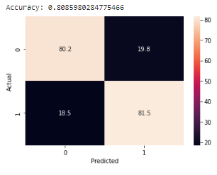
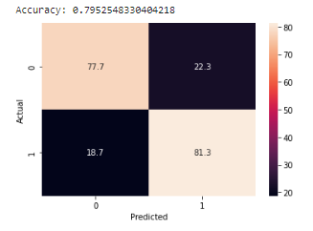
Building Machine Learning Model
The selected features were divided into training and testing sets once more using the scikit-learn package, with 80% training and 20% test.
Random Forest classification was used on the datasets which is divided into two classes (correctly cleaved and missed cleaved). The model was trained with 1000 trees.
Additionally, Shap's feature importance analysis was determined from the model performance after it had been trained and tested.
A2 Dataset
PTEN Dataset
Notes:
The calculated features in the DataFrame is pre-processed as input into the machine learning models to predict missed cleavages. The particular model we used is Random Forest (RF), an algorithm which can perform both classification and regression tasks with high accuracy of prediction. The data is split into 80 to 20 % for both datasets. As you can see that in the confusion matrix , there is a high accurate performance with both high % for true positives and true negatives.

Slide 10
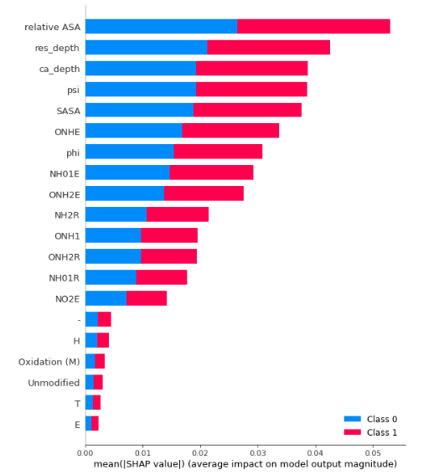
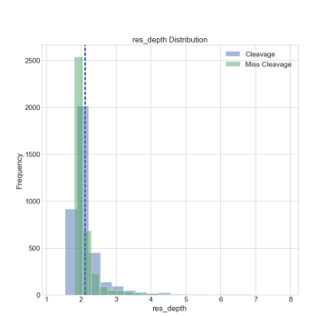
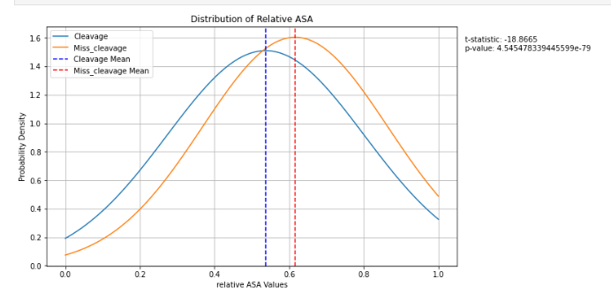

Results from (PTEN) & Conclusion
Notes:
The first figure shows the permutation-based feature importance, which is the reduction in model score caused by randomly shuffling a single feature value. The technique eliminates the link between the feature and the target, and the decrease in model score reflects how much the feature is relied upon. The model demonstrated very comparable feature importance, with relative ASA ranking first and residue depth coming in second. This means that both features show great importance in the model of the PTEN dataset. In addition to the first figure, the other graphs shows the distribution of both of most important features in the model, while looking at the distribution show that there is no clear difference & the mean of both features is also similar. the independent t-test values with a p-values of below 0.05 suggests there are significant differences between the groups of missed cleavage and cleavage. Therefore, there is a conclusion that some of the feature have an influence on likelihood of a successful cleavage.

Slide 11

Future Work & Opportunities for Development
Try XG Boost Model
More MS datasets is required to test the model.
Implementing & integrating the model into the peptide detectability prediction pipeline.
Thank you for listening . Questions?
Notes:
Furthermore, in the future of this project, we are planning to enhance the research by implementing new machine learning models like XG Boost, using different levels of protein structure features other than secondary to predict missed cleavage and carrying out further testing on more unseen and larger datasets on the model for test generalisation
Feedback:
explain more information on PTEN and A2 datasets/ mention cell line and silencing of certain genes(PTEN and A2) and labelling Which is silac (A2)

